Slide 1
Chapter 2 Configuration Space
Chapter 3 Rigid-Body Motions
Chapter 4 Forward Kinematics
Chapter 5 Velocity Kinematics and Statics
Chapter 6 Inverse Kinematics
Chapter 7 Kinematics of Closed Chains
Chapter 8 Dynamics of Open Chains
8.1 Lagrangian Formulation
Chapter 9 Trajectory Generation
Chapter 10 Motion Planning
Chapter 11 Robot Control
Chapter 12 Grasping and Manipulation
Chapter 13 Wheeled Mobile Robots

Slide 2
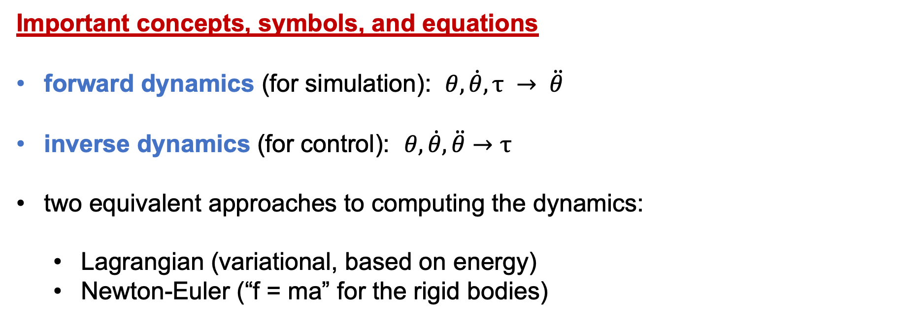
Important concepts, symbols, and equations
forward dynamics (for simulation): $θ, \dot{θ}, τ → \ddot{θ}$
inverse dynamics (for control): $θ, \dot{θ},\ddot{θ}→τ$
two equivalent approaches to computing the dynamics:
Lagrangian (variational, based on energy)
Newton-Euler (“f = ma” for the rigid bodies)

Slide 3
Important concepts, symbols, and equations (cont.)
Lagrangian approach:
Lagrangian
eqs of motion
kinetic minus potential energy
∈ ℝ^{n}
in components

Slide 4
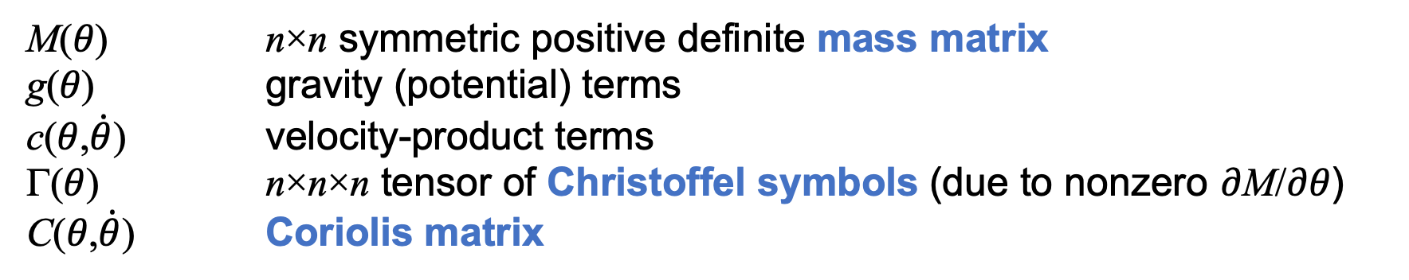
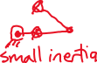
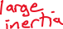
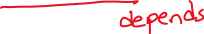
Important concepts, symbols, and equations (cont.)
Standard forms of dynamic equations:
+
M(𝜃) n×n symmetric positive definite mass matrix
g(𝜃) gravity (potential) terms
c(𝜃,$\dot{θ}$) velocity-product terms
Γ(𝜃) n×n×n tensor of Christoffel symbols (due to nonzero 𝜕M/𝜕𝜃)
C(𝜃,$\dot{θ}$) Coriolis matrix

Slide 5
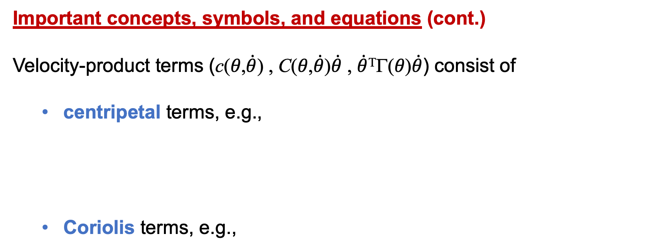
Important concepts, symbols, and equations (cont.)
Velocity-product terms (c(𝜃,$\dot{θ}$) , C(𝜃,$\dot{θ}$)$\dot{θ}$ , $\dot{θ}$^{Τ}Γ(𝜃)$\dot{θ}$) consist of
centripetal terms, e.g.,
Coriolis terms, e.g.,
)

Slide 6
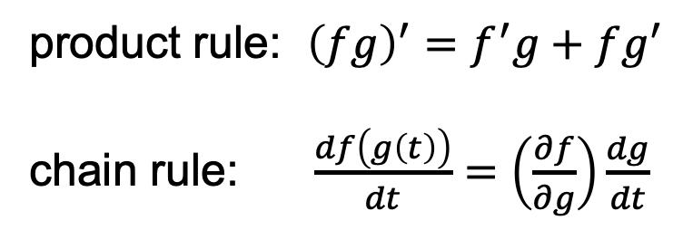
RP in gravity
= + ...
= L₁ + ...
product rule: ${\left(fg\right)}^{′}=f^{′}g+fg^{′}$
chain rule: $\frac{df\left(g\left(t\right)\right)}{dt}=\left(\frac{∂f}{∂g}\right)\frac{dg}{dt}$

Slide 7

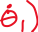
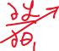
RP in gravity
L₁ =
Contribution to 𝜏₂:
Contribution to 𝜏₁:

Slide 8
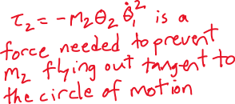
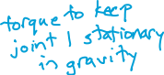
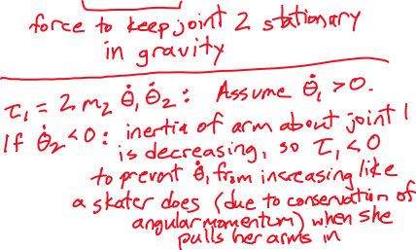
RP in gravity
Explain the velocity-product terms.

